Slide 1
February 17th Sprint Presentation
Capstone Defence

Slide 2
User Stories for Sprint 3
As a gamer, I want to view my scores on a publicly visible leaderboard.
As a gamer, I want to be able to use Google authentication to log into my account.
As a gamer, I want to view a new high score on the leaderboard if I exceed my previous high score.
As a gamer, I want to view the health status of my character.
As a gamer, I want the towers in the user interface to be functional.
As a gamer, I want to control my player using real-time physics.
As a gamer, I want to be able to choose different worlds to play in.
As a gamer, I want to be able to activate a menu to play the game.
As a gamer, I want to be able to activate a menu to access settings.
As a gamer, I want an easy way to quit the game in the middle of playing it.
As a gamer, I want to be able to access an in-game menu.

Slide 3

ORM Setup
We decided on using python as an orm for our project
Every query handled in php has been ported to python
Python is neat in the sense of logic handling for the website and adding in a layer of security

Slide 4


Fire Base & Google Authentication
Firebase is a NoSQL database and for our current configuration we are using a relational database.
Google Authentication is a good to have feature, but at the moment isn’t a necessity.

Slide 5
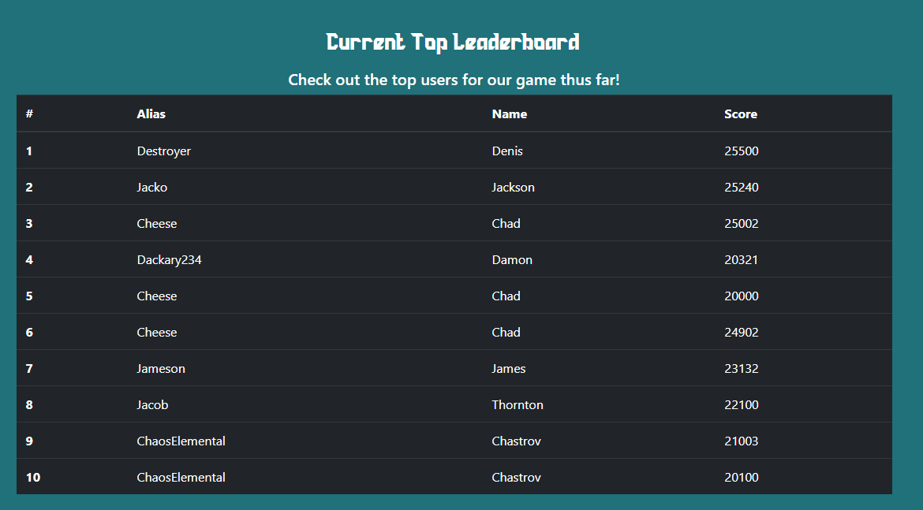
Connecting Database to Website Leaderboard
At the moment, scoring has not been implemented
A dummy table is being used to display data that is linked to SQL database
Python is handling the logic behind implementing the leaderboard
Created leaderboards on profile page, home, and leaderboards page

Slide 6


Applying Health Systems
Tower’s Health
AI Currently doesn’t target towers
Working on better world generation so that we can have a target other than the player
AI’s Health
Anytime a Enemy goes into a tower’s target range it will be targeted by any cannon that currently doesn’t have a target

Slide 7
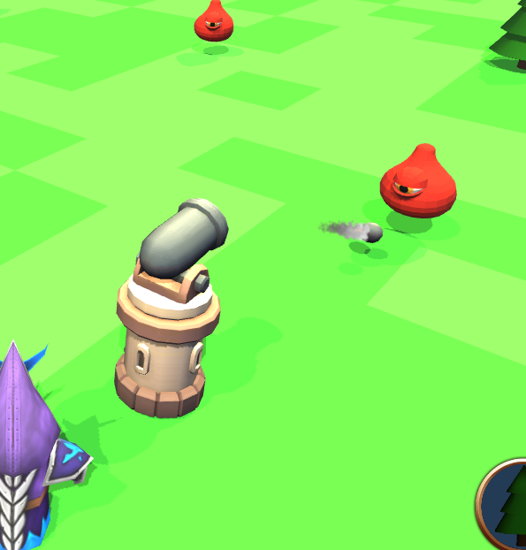
Tower Functionality
Tower’s Spawn with full functionality
Health System
Damage modifiers are allowed
Targets Enemies
Uses proper animations and pivoting

Slide 8
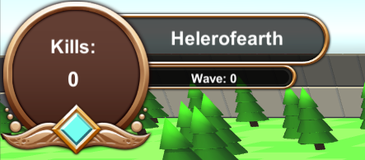

Outputting Leaderboard Score
Currently tracking two scores to be output to the leaderboard
Wave Number
Resource Amount

Slide 9
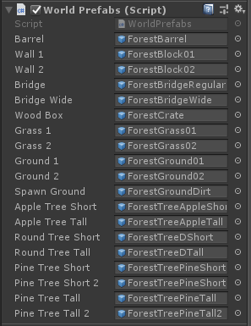
World Generation
Work is being done for better procedural generation
Conflicts came in place with storing everything how we envisioned it.

Slide 10
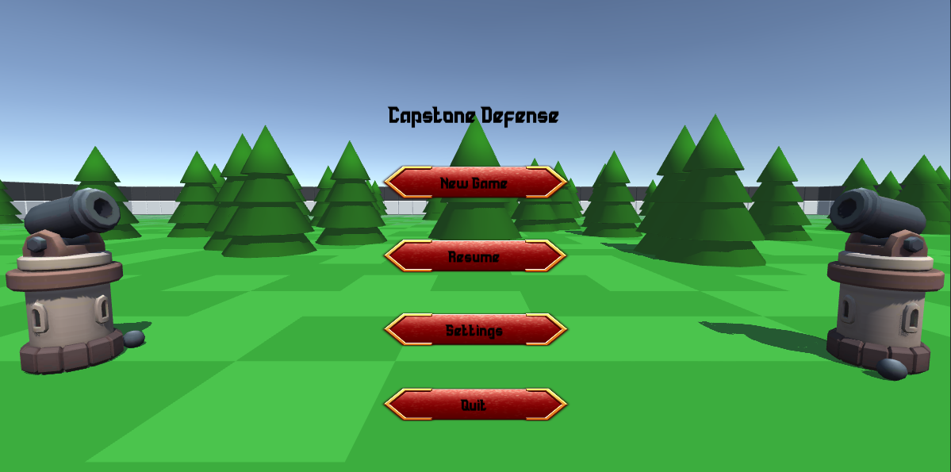
Landing Screen

Slide 11

In-game Menu
Serialization/persistent memory

Slide 12
Quality Assurance Testing
WEBSITE FUNCTIONALITY
Mobile testing
IOS and Android have functional navbars now.
Unity demo functional across all browsers.
User Account Creation
Needs confirm password for extra security when creating accounts.
Email verification with link and security code fully functional on desktop web browsers. Tested on chrome, firefox, safari and edge.
Need verification to confirm login status on the top of the page.
Currently there is no way to verify if a user is currently logged in to their account on the website.
Need to redirect users to the main playable game page when logged in successfully.
GAME FUNCTIONALITY
Old build still functioning properly on the demo page of the website.
Current issues include collision on objects are not working properly but collision is working properly within the editor.
Take a break reminder pops up as intended but does not disappear currently and sits at the top of the game.
Building towers and placing them on the map is functioning as intended.
Scoring still needs to be implemented and tested.

Slide 13
Quality Assurance Testing
UI FUNCTIONALITY
Need to build a health bar that is easily seen by players indicating health of home base structure.
Resource management bar is implemented, needs to be tested further based on progression through the game.
Gear icon implemented in the UI which brings up the paused menu, working as intended.
Considering adding enemy health bars to help with identifying how much damage is being done by the player.
DATABASE TESTING
ORM layer code installed.
Firebase installed to pull data from unity to populate the leaderboard database.

Slide 14
Next Sprint
Improving game controls
Making landing menu fully functional
Add more fields to account creation page (confirm password field, etc.)
Show that the user is logged in
Improving “take a break” reminder
Game continuation after pausing (need to implement ourselves)
Continued design tweaks

Slide 15
Demo

